Slide 1



Multiplication Algorithm (Signed Magnitude) Session No.: 21 Course Name: Computer Organization & Architecture Course Code: R1UC305T Instructor Name: Vimal Singh

Slide 2
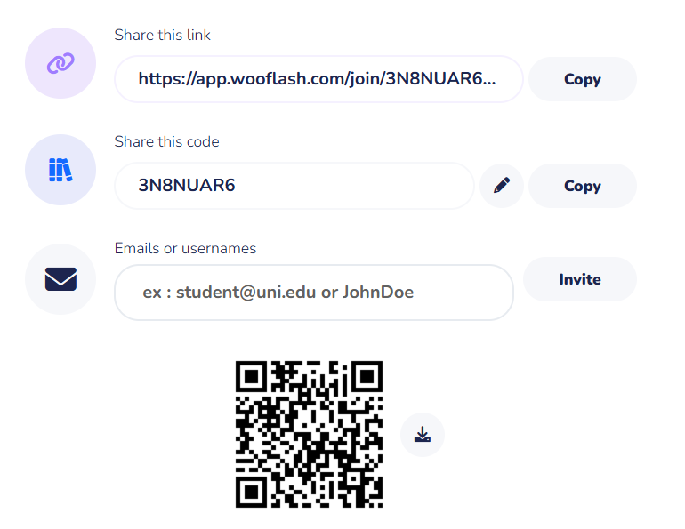
Pre Course Assesment

Slide 3
Recap:
Addition and
Subtraction
(Signed Magnitude and Signed 2’s Complement)

Slide 4
At the end of this session students will be able to
Learning Outcome 1: Perform Multiplication using signed magnitude
Learning Outcome 2: Explain hardware implementation for signed magnitude algorithm

Slide 5
Opening Activity:

Slide 6
Session Outline
1 Binary Number System
2 Signed Magnitude Addition
3 Signed Magnitude Subtraction
4 2’s Complement Addition
5 2’s Complement Subtraction
6 Learning Activity

Slide 7
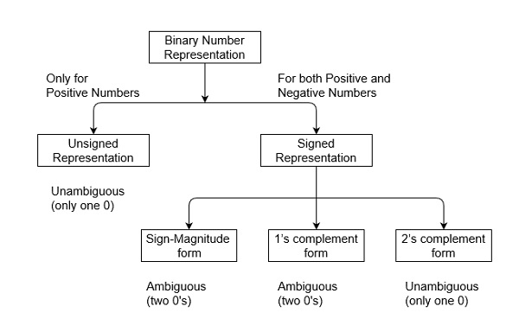
Binary Number System

Slide 8
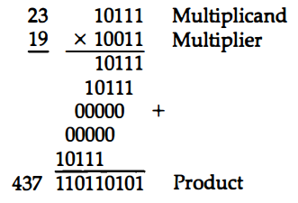
Multiplication Algorithms
(Binary Multiplication for Signed Magnitude)
If the multiplier bit is a 1, the multiplicand is copied down; otherwise, zeros are copied down. The numbers copied down in successive lines are shifted one position to the left from the previous number. Finally, the numbers are added and their sum forms the product.
The sign of the product is determined from the signs of the multiplicand and multiplier. If they are alike, the sign of the product is positive. If they are unlike, the sign of the product is negative.

Slide 9
Algorithm for Signed Magnitude Binary Multiplication
Initially the multiplicand in B and multiplier in Q, the corresponding sign in Bs and Qs.
Multiplicand : B
Multiplier : Q
LSB of Q is : Qn
E←0
A←0
If Qn is 1 then EA←A+B ;
If Qn is 0 then do nothing.
Shift right register EAQ
SC←SC-1
Final product is in AQ

Slide 10
Example: 23 X 19
If Qn is 1 then EA←A+B ;
If Qn is 0 then do nothing.
Shift right register EAQ
SC←SC-1
Multiplicand B = 10111 | E | A | Q | SC
 | 0 | 00000 | 10011 | 101

Slide 11
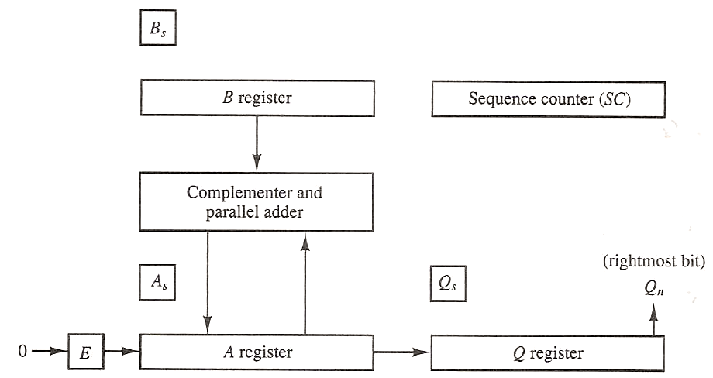
Hardware for Signed – Magnitude Binary Multiplier

Slide 12
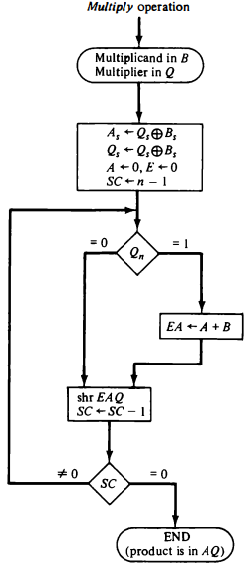
Flowchart for Multiplication Operation

Slide 13
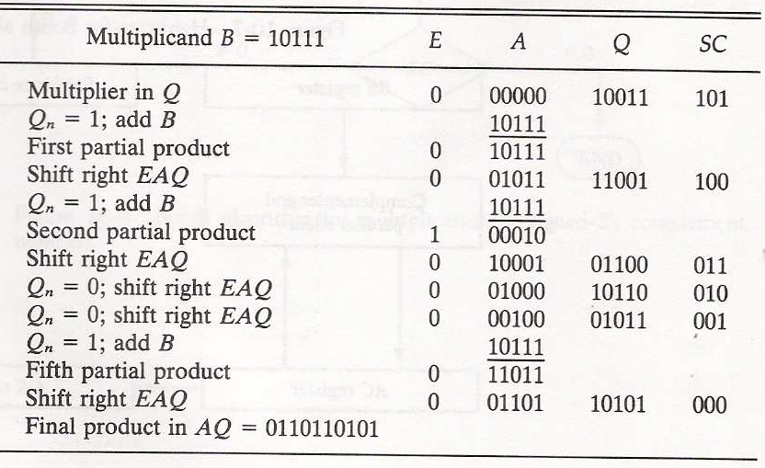

Slide 14
Learning Activity 1(a): Pen and Paper Activity
Example 1: -9x12

Slide 15
Summary
In signed magnitude multiplication, the sign and magnitude are handled separately.
Step 1: Sign Decision – The result is positive if both operands have the same sign, and negative if the signs differ.
Step 2: Magnitude Multiplication – The magnitudes (absolute values) of the numbers are multiplied using standard binary multiplication (shift-and-add method).
Step 3: Combine Result – Attach the decided sign to the magnitude product.

Slide 16
Ensure attainment of LOs in alignment to the learning activities: outcomes (1-2)
Learning Outcome 1: Performed Multiplication using signed magnitude
Learning Outcome 2: Explained hardware implementation for signed magnitude algorithm

Slide 17
Discussion on the post session activities
Multiply the following using Signed Magnitude Algorithm:
(+6) × (+5)
(–7) × (+3)
(–4) × (–9)

Slide 18

Review and Reflection from students

Slide 19
Thank You

